Slide 1
Cyber Security Challenge Walkthrough
Joshua Harp and Brian Saenz

Slide 2
Easy Challenge - Hashes
Cracking!
First three are just hashes that have to be cracked.
Last one is a password protected file, but you can extract the hash and crack it the same way.
Tools
John the Ripper or Hascat
Know your tool.
Manual pages help
Important to know:
Format of the hash or password.
How to load it into the program.
It can take time.

Slide 3
Easy Challenge - Hashes
Lessons Learned
Cracking takes time
It helps to have parameters, wordlists.
Rainbow tables are pre cracked passwords, just does a comparison.
Cracking is easier than bruteforcing a field, but less likely to occur.
The longer and more complex the password, the longer it takes.
New hashing algorithms increase cost and keyspace.

Slide 4
Easy Challenge - Hashes

Slide 5
Easy Challenge - Hashes

Slide 6
Easy Challenge - Hashes

Slide 7
Easy Challenge - Hashes

Slide 8
Easy Challenge - PCAPs
Tools
Wireshark
Open up the pcap and get to work.
Follow streams

Slide 9
Easy Challenge - PCAPs
Tools
Wireshark
Open up the pcap and get to work.
Follow streams
1. What was the intruder’s email?

Slide 10
Easy Challenge - PCAPs
Tools
Wireshark
Open up the pcap and get to work.
Follow streams
2. What was the intruder’s password?

Slide 11
Easy Challenge - PCAPs
Tools
Wireshark
Open up the pcap and get to work.
Follow streams
2. What was the intruder’s password?

Slide 12
Easy Challenge - PCAPs
Tools
Wireshark
Open up the pcap and get to work.
Follow streams
3. What was the accomplice’s email?

Slide 13
Easy Challenge - PCAPs
Tools
Wireshark
Open up the pcap and get to work.
Follow streams
3. What was the accomplice’s email?

Slide 14
Easy Challenge - PCAPs
Tools
Wireshark
Open up the pcap and get to work.
Follow streams
4. What was the name of the attachment?

Slide 15
Easy Challenge - PCAPs
Lessons Learned
Cleartext protocols are bad. Use secure protocols whenever possible.
We were able to see content because of SMTP
Basic authentication is just that
Lots of ways to securely handle authentication
Sometimes you have to hike up your pants and wade through the data.

Slide 16
Intermediate challenge
Forked from WackoPicko
https://github.com/adamdoupe/WackoPicko
Original use was to test web application vulnerability scanners.
Yes, there are more vulnerabilities then what is listed on the guide.
7yr old project still relevant today.

Slide 17
OWASP Top 10
Non-profit providing unbiased, practical information about application security.
76% of government apps failed the initial OWASP Top 10 risk assessment.
Wiki’s are a great resource for learning!
Phoenix Chapter (https://www.meetup.com/owasp-phoenix/)

Slide 18
Hard/insane challenge
Originally basement CTF from dc416 (Def Con Toronto)
Developed by the VulnHub CTF team
Specifically @barrebas
There are a total of four in the series
Baffle
Dick dastardly
Fortress

Slide 19
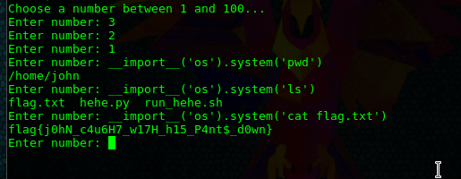
The first flag!

Slide 20
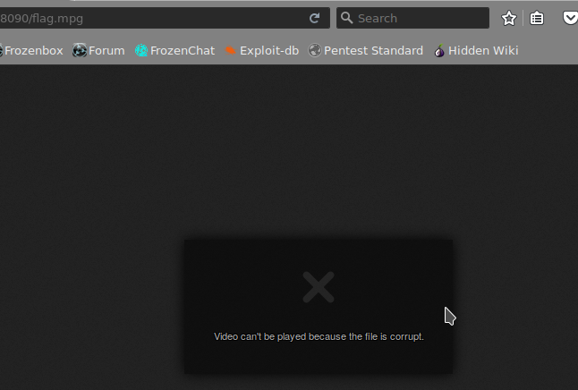
The Second flag!

Slide 21
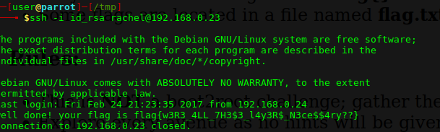
The Third Flag

Slide 22
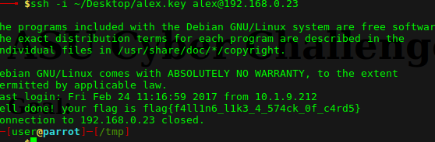
The fourth flag

Slide 23
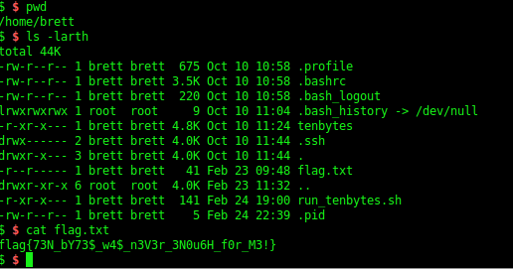
The fifth flag!

Slide 24
Questions?

